Slide 1
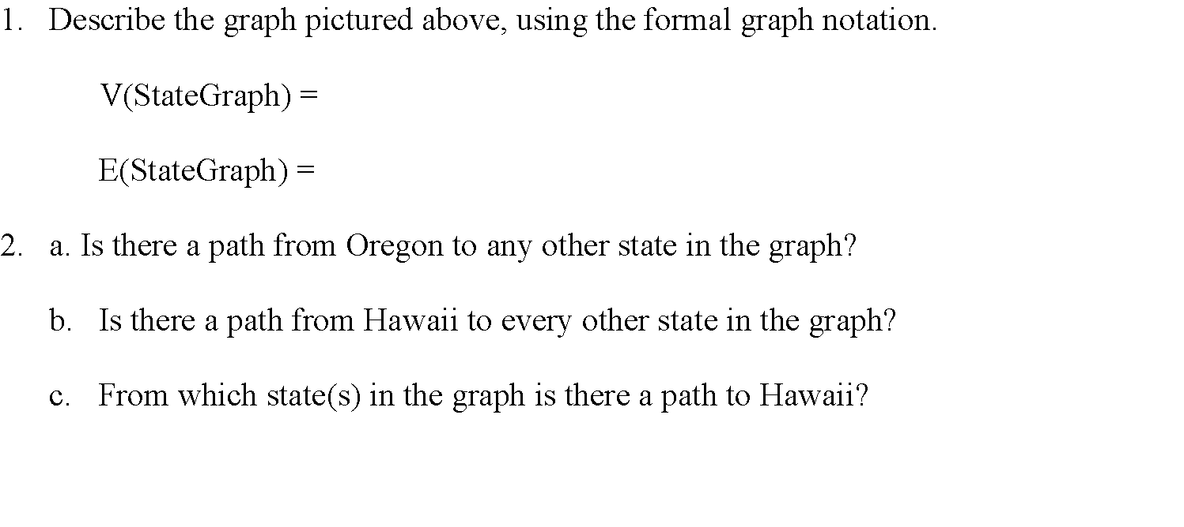
CMSC204
Kartchner
V(StateGraph) = {Oregon, Alaska, Texas, Hawaii, Vermont, NewYork, California}
E(StateGraph) = {(Alaska, Oregon), (Hawaii, Alaska), (Hawaii, Texas), (Texas, Hawaii), (Hawaii, California), (Hawaii, New York), (Texas, Vermont), (Vermont, California), (Vermont, Alaska)}
1. Draw the StateGraph
Oregon
Alaska
Hawaii
New York
California
Texas
Vermont
{Oregon, Alaska, Texas, Hawaii, Vermont, New York, California}
{(Alaska, Oregon). (Hawaii, Alaska), (Hawaii, Texas), (Texas, Hawaii), (Hawaii, California), (Hawaii, New York), (Texas, Vermont), (Vermont, California), Vermont, Alaska)}
No
Yes
Texas

Slide 2
a. Show the adjacency matrix that would describe the edges in the graph. Store the vertices in alphabetical order
A C H N O T V
States
Alaska
California
Hawaii
New York
Oregon
Texas
Vermont
0 | 0 | 0 | 0 | 1 | 0 | 0
0 | 0 | 0 | 0 | 0 | 0 | 0
1 | 1 | 0 | 1 | 0 | 1 | 0
0 | 0 | 0 | 0 | 0 | 0 | 0
0 | 0 | 0 | 0 | 0 | 0 | 0
0 | 0 | 1 | 0 | 0 | 0 | 1
1 | 1 | 0 | 0 | 0 | 0 | 0
3. b. Show the adjacency lists
that would describe the edges in the graph
Alaska
California
Hawaii
New York
Oregon
Texas
Vermont
Oregon
Alaska California New York Texas
Hawaii Vermont
Alaska California

Slide 3
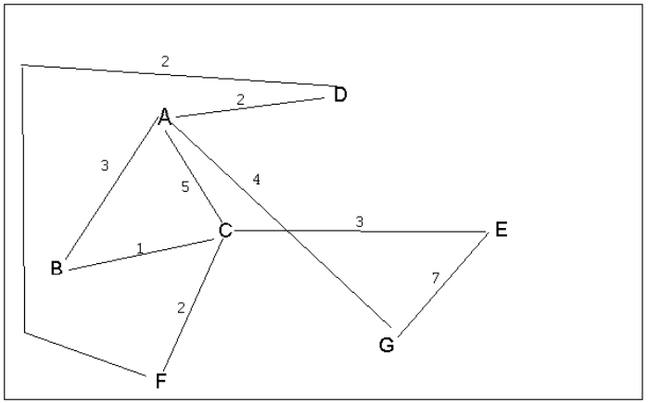
4 a. Which of the following lists the graph nodes in depth first order beginning with E?
A) E, G, F, C, D, B, A
B) G, A, E, C, B, F, D
C) E, G, A, D, F, C, B
D) E, C, F, B, A, D, G
4 b. Which of the following lists the graph nodes in breadth first order beginning at F?
A) F, C, D, A, B, E, G
B) F, D, C, A, B, C, G
C) F, C, D, B, G, A, E
D) a, b, and c are all breadth first traversals

Slide 4
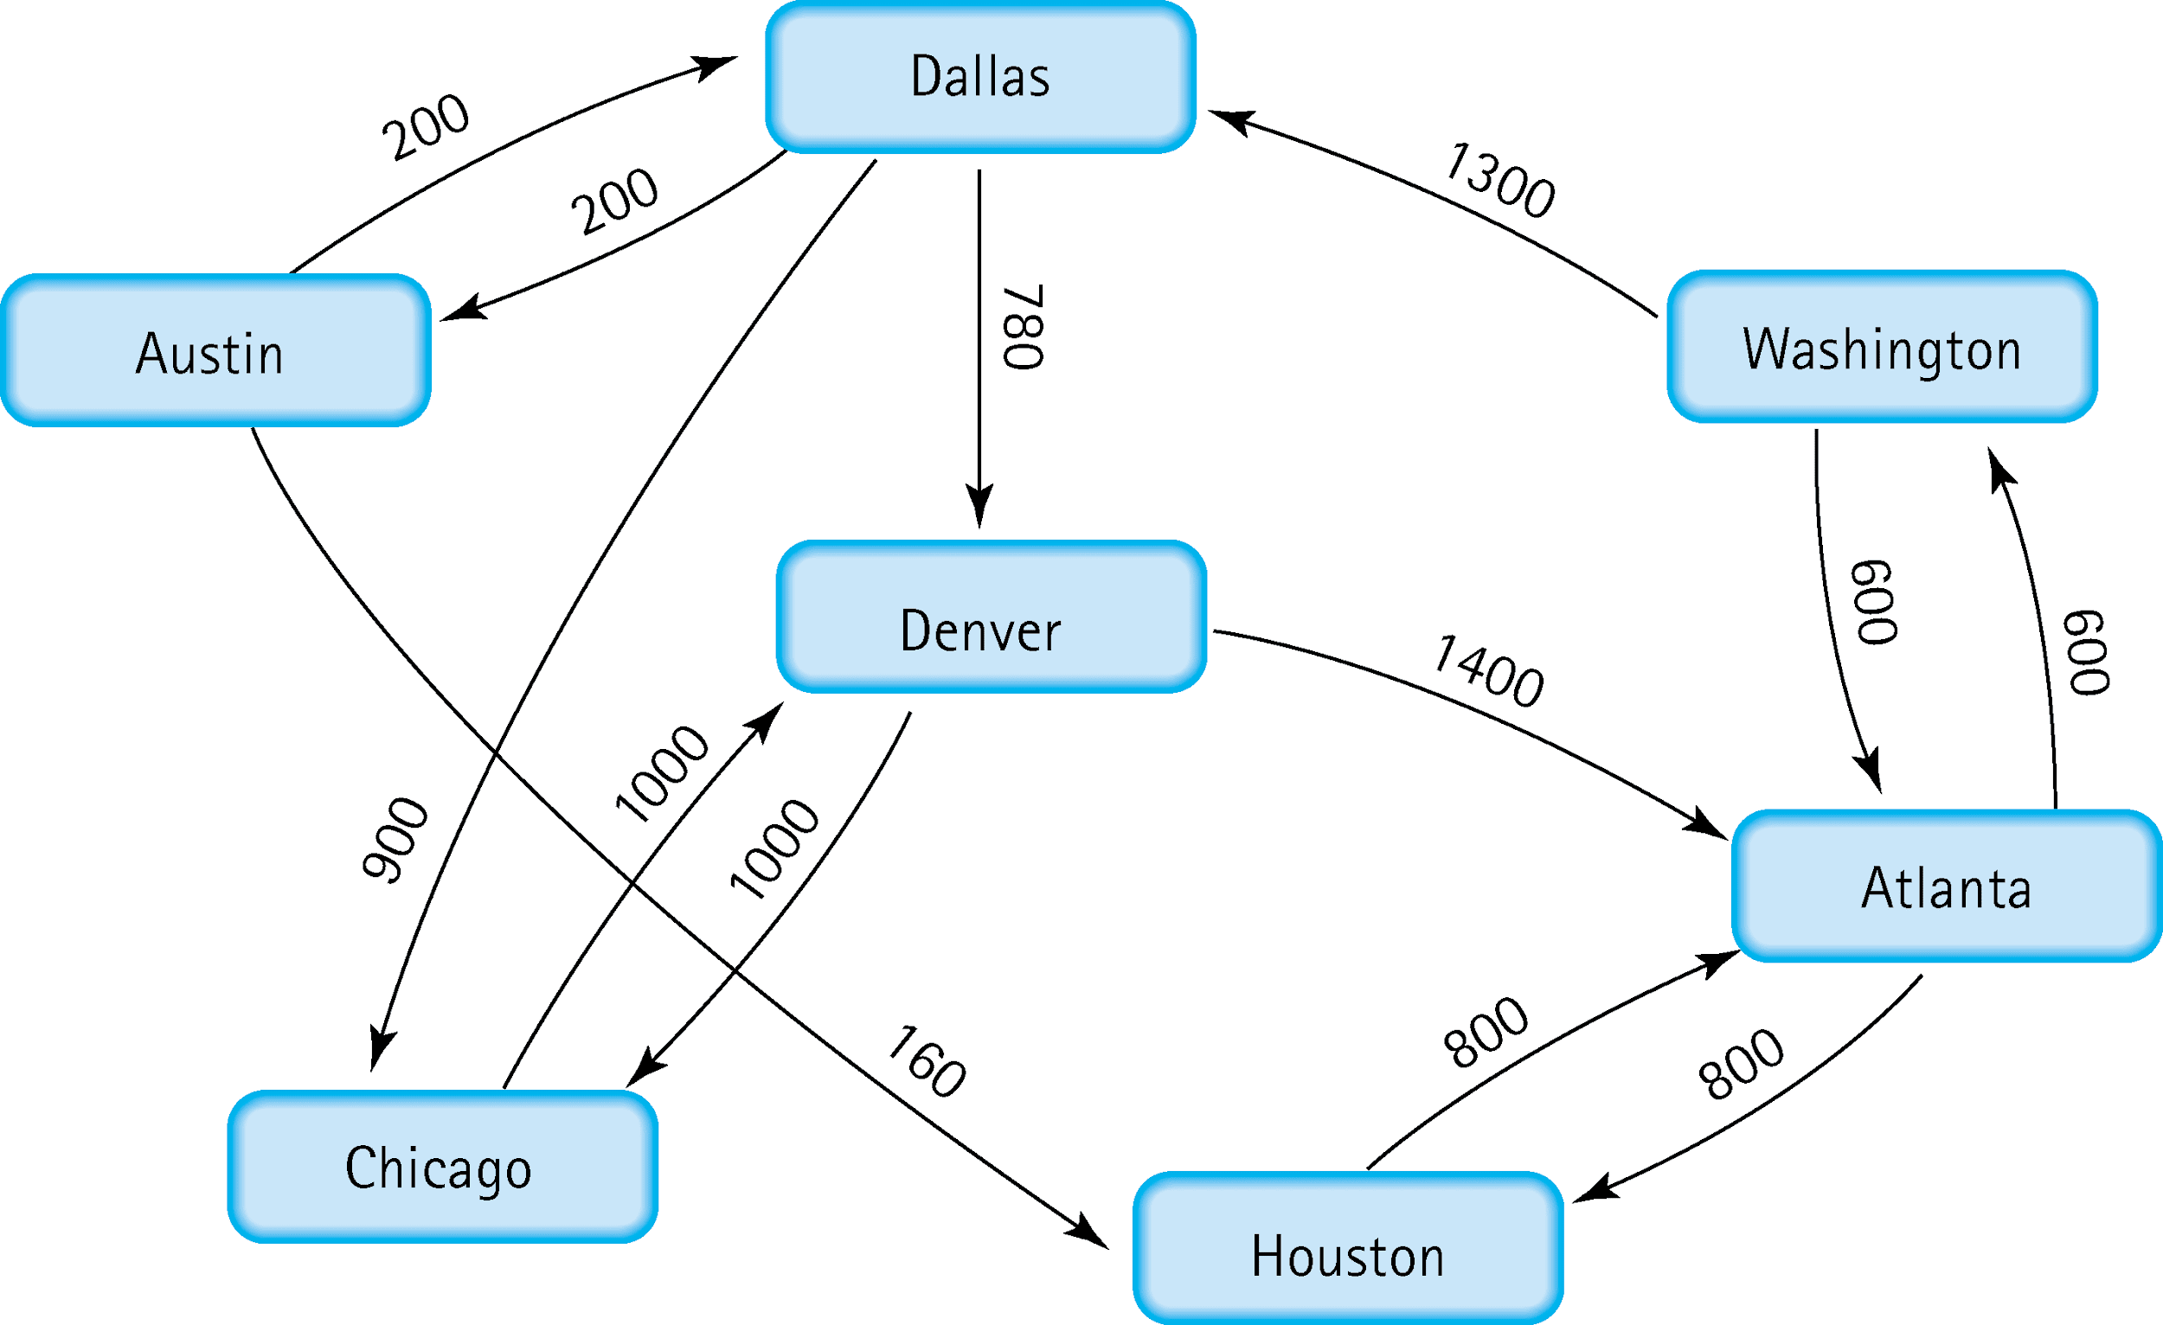
5. Find the shortest distance from Atlanta to every other city
Austin | Washington Dallas Austin = 2100
Chicago | Washington Dallas Chicago = 2800
Dallas | Washington Dallas = 1900
Denver | Washington Dallas Denver = 2680
Houston | Houston = 800
Washington | Washington = 600

Slide 5
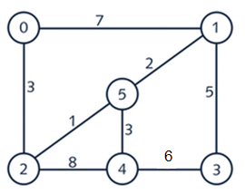
6. Find the minimal spanning tree using Prim’s algorithm. Use
0 as the source vertex . Show the steps.
0
1
5
2
4
3
0
1
5
Vertex 0 is added
Consider edge weights 7 and 3, add edge 3 and vertex 2
Consider edge weights 7, 1, and 8, add edge 1 and vertex 5
Consider edge weights 7, 2, 3, and 8, add edge 2 and vertex 1
Consider edge weights 3, 5, and 8, add edge 3 and vertex 4
Consider edge weights 5 and 6, add edge 5 and vertex 3
2
4
3
0
1
5
2
4
3
0
1
5
2
4
3
0
1
5
2
4
3

Slide 6
7. Find the minimal spanning tree using Kruskal’s algorithm.
Show the weights in order and the steps.
0
1
5
2
4
3
0
1
5
Edge Weight
0-1 7
0-2 3
1-3 5
1-5 2
2-4 8
2-5 1
3-4 6
4-5 3
2
4
3
0
1
5
2
4
3
Edge Weight
2-5 1
1-5 2
0-2 3
4-5 3
1-3 5
3-4 6
0-1 7
2-4 8
0
1
5
2
4
3
0
1
5
2
4
3

Slide 7
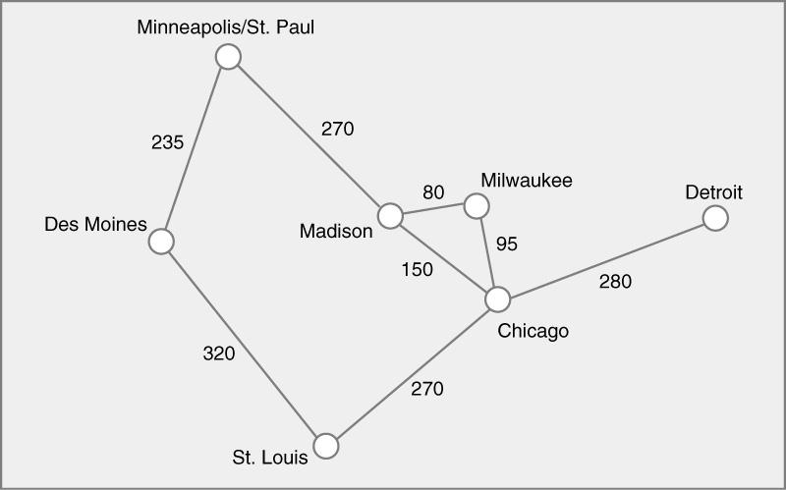
8. Find the minimal spanning tree using the algorithm you prefer. Use
Minneapolis/St. Paul as the source vertex
Minneapolis/St. Paul is added
Consider edge weights 235 and 270, add edge 235 and Des Moines
Consider edge weights 270 and 320, add edge 270 and Madison
Consider edge weights 320, 150, and 80, add edge 80 and Milwaukee
Consider edge weights 320, 150, and 95, add edge 95 and Chicago
Consider edge weights 320, 270, and 280, add edge 270 and St.Louis
Add edge weight 280 and Detroit

Slide 8
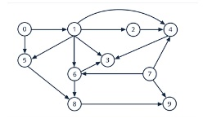
9. List the nodes of the graph in a breadth first topological ordering. Show the
steps using arrays predCount, topologicalOrder and a queue
0 1 2 3 4 5 6 7 8 9
predCount
0 | 1 | 1 | 3 | 3 | 2 | 2 | 0 | 2 | 2
0 | 7 | 1 | 2 | 5 | 6 | 4 | 8 | 3 | 9
topologicalOrder
queue
0,7,1,2,5,6,4,8,3,9
predCount
- | 0 | 1 | 3 | 2 | 1 | 1 | - | 2 | 1
- | - | 0 | 2 | 1 | 0 | 0 | - | 2 | 1
- | - | - | 1 | 0 | - | - | - | 0 | 1
- | - | - | 0 | - | - | - | - | - | 0
predCount
predCount
predCount

Slide 9
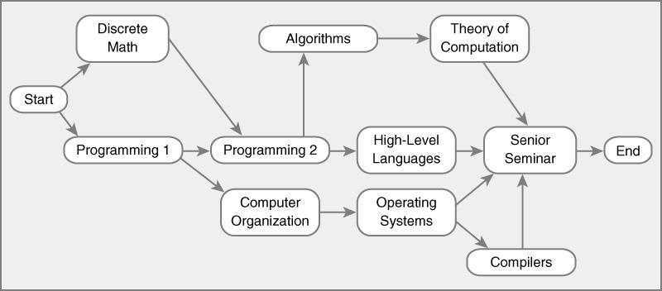
10. List the nodes of the graph in a breadth first topological ordering.
0 1 2 3 4 5 6 7 8 9 10 11
predCount
0 | 1 | 1 | 2 | 1 | 1 | 1 | 1 | 1 | 4 | 1 | 1
S | D | P1 | P2 | C | A | O | H | T | C | SS | E
topologicalOrder
queue
Start, Discrete Math, Programming 1,Programming 2, Computer Organization, Algorithms, Operating Systems, High-Level Languages, Theory of Computation, Compilers, Senior Seminar, End
predCount
- | 0 | 0 | 2 | 1 | 1 | 1 | 1 | 1 | 4 | 1 | 1
- | - | - | 0 | 0 | 1 | 1 | 1 | 1 | 4 | 1 | 1
- | - | - | - | - | 0 | 0 | 0 | 1 | 4 | 1 | 1
- | - | - | - | - | - | - | - | 0 | 2 | 0 | 1
- | - | - | - | - | - | - | - | - | 0 | - | 1
- | - | - | - | - | - | - | - | - | - | - | 0
predCount
predCount
predCount
predCount
predCount

